Slide 1
GYM MANAGEMENT SOFTWARE
Hassan Anwar 18072
Farrukh Arain 17877

Slide 2
PROBLEM (why we wanted to create this site)
Coronavirus global pandemic has turned the fitness industry upside down almost overnight.
In 2020, gym owners have received cancellation requests, a drop in sales and package repurchases.
With rentals and salaries to pay, and no revenue to speak of, many gyms have shut down.
There have been thousands of job losses.
Many fitness coaches and support staff were sent on leave without pay or reduced pay.

Slide 3
Surveys
As there are two main actors involved in our surveys so we conducted two different surveys
One was for users (i.e. members) and other was for gym owners ( who will hire the trainers)
The main goal of the survey was to know the demand of the online gym and to know specific requirements of both, users and owners, for the website.

Slide 4
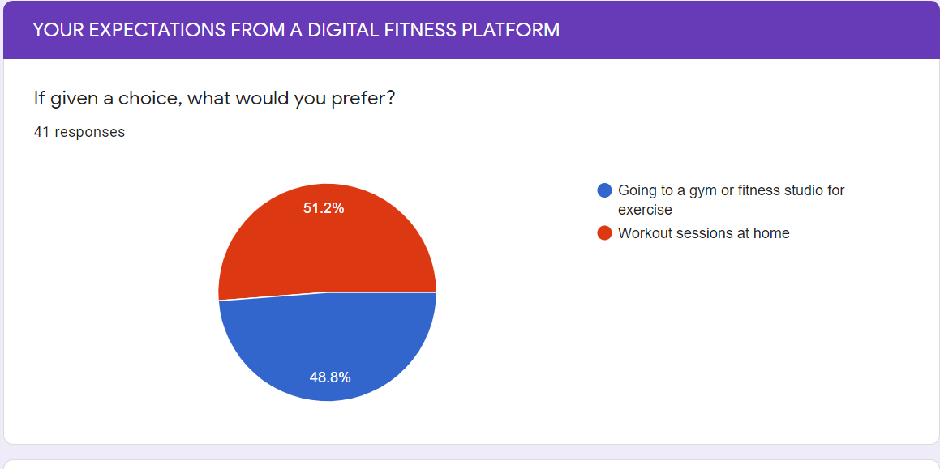
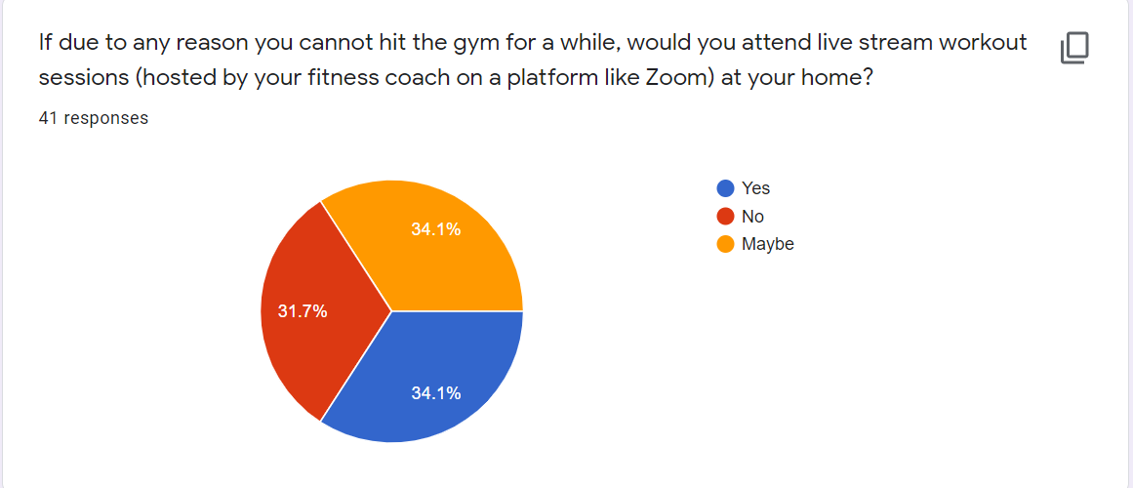
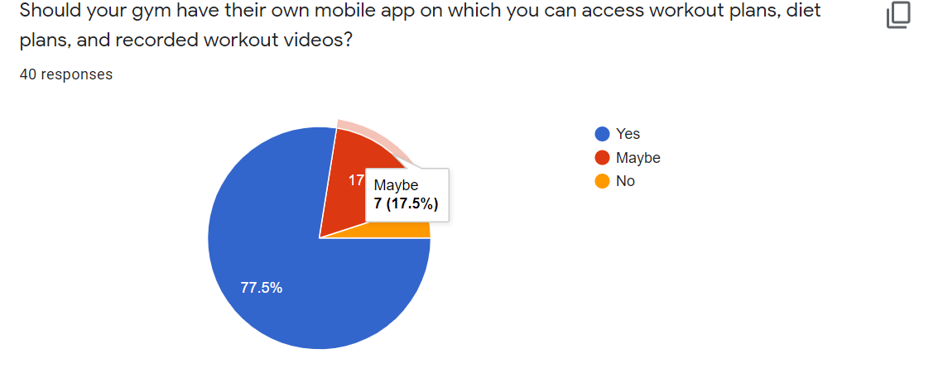
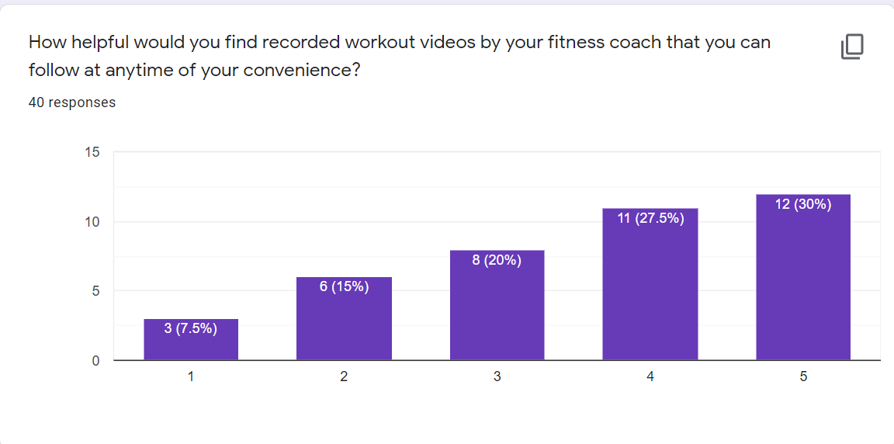
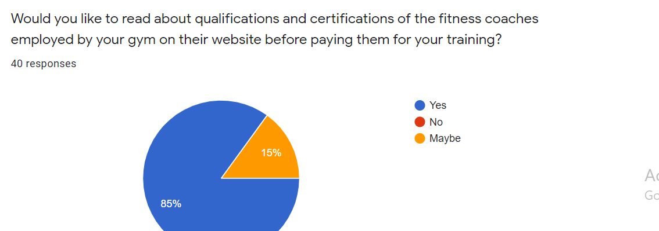
Survey from User Perspective

Slide 5
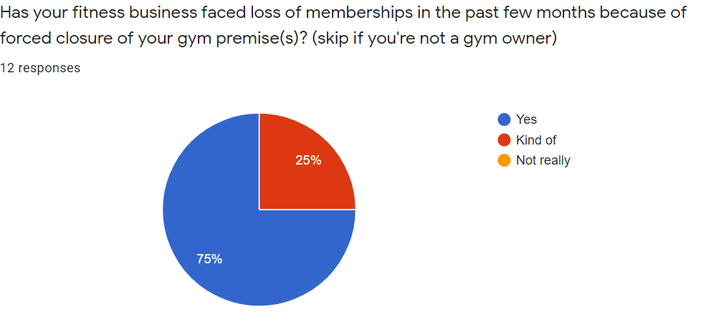
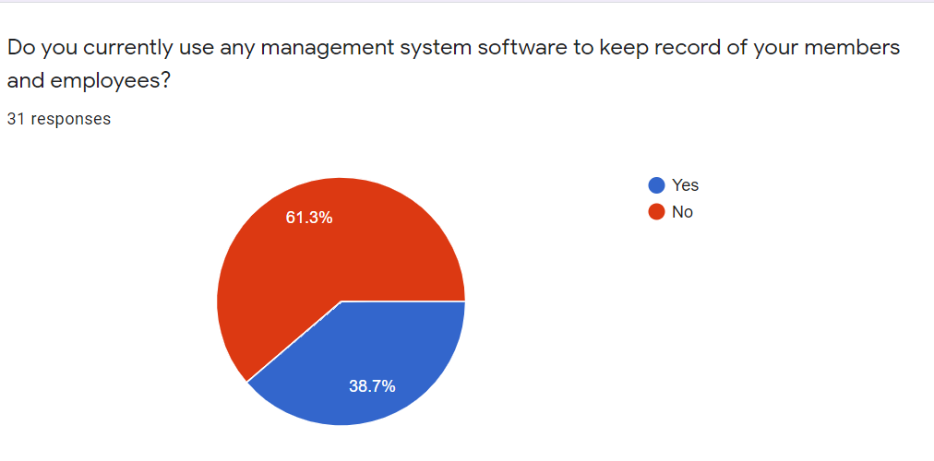
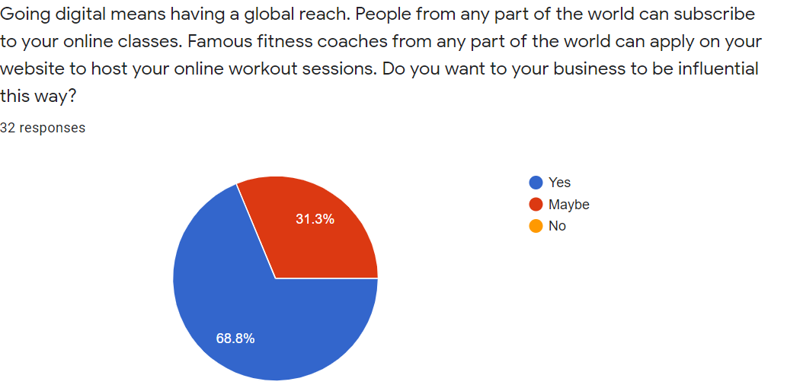
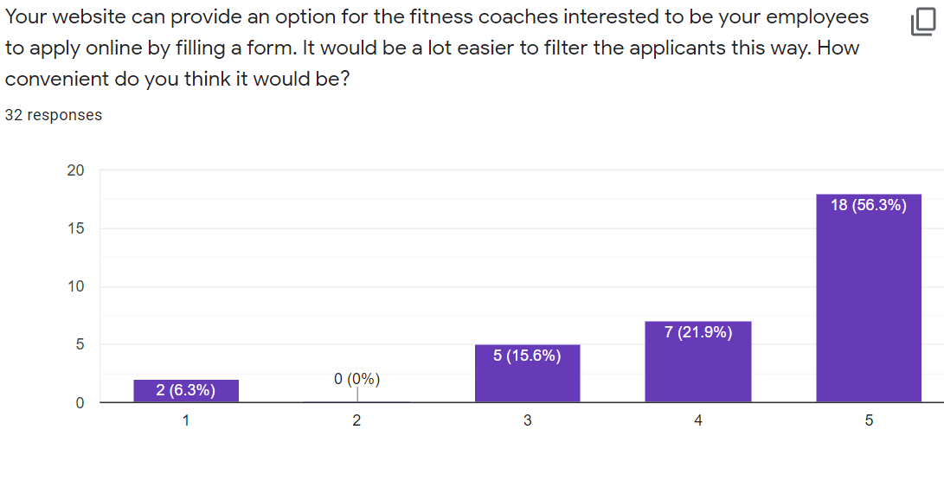
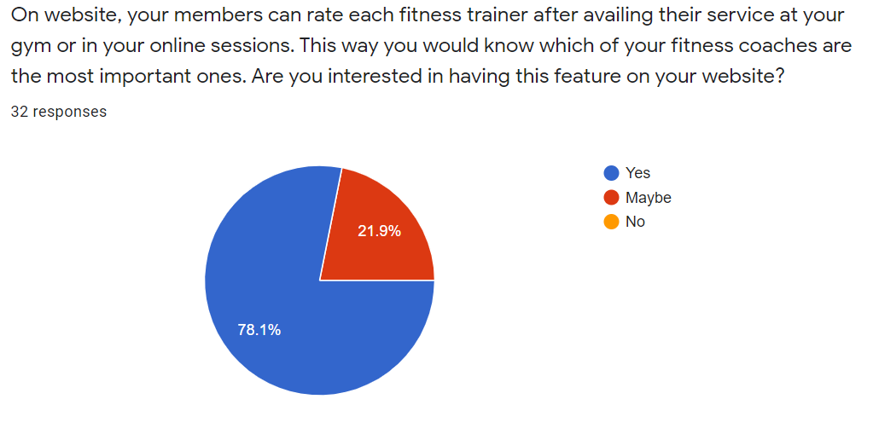
Survey from Gym Owner’s Perspective

Slide 6
Survey Analysis
Demand:
The corona Virus has affected the fitness industry severely. Gym owners went into losses and trainers lost their jobs.
So, there is a high demand of moving the gym and other fitness platforms to online
Specific Needs of customers
Users: they want live sessions (via zoom) so they could have their session(s) (at home) under the live instructions from trainers and if they miss them, they could also watch the recording ones.
They want to see how reliable a trainer is by having his/her qualifications and certifications pasted on his profile.
Gym owners : they want trainers to apply for their gym via online form
They want to see the progress of the trainers by analyzing how they are being rated on their services.

Slide 7
Potential Benefits.
Virtual fitness is here to stay for the following reasons:
Gyms and studios that did not have a digital presence and could not be discovered online can now market their business online by going digital.
Onsite gym facility comes with the drawback of limited capacity inside the premise.
The cost of setting up a virtual gym is very low as compared to setting up an onsite gym or expanding your fitness business by opening another branch.
By offering an online service, you become available for subscription to every person with an internet connection, no matter in what part of the world they are!
Build a name around the globe by hiring famous fitness coaches from different parts of the world.

Slide 8
Our Gym management system

Slide 9
ABOUT OUR GYM MANAGEMENT SYSTEM
Our gym management system is a web application.
There are two types of persons that can create their account: members and fitness instructors.
There are three types of services offered: class, on-demand videos package, and diet plan.
A fitness instructor from anywhere can create and offer any of these three types of services.
A member can get access to any of these three types of services.

Slide 10
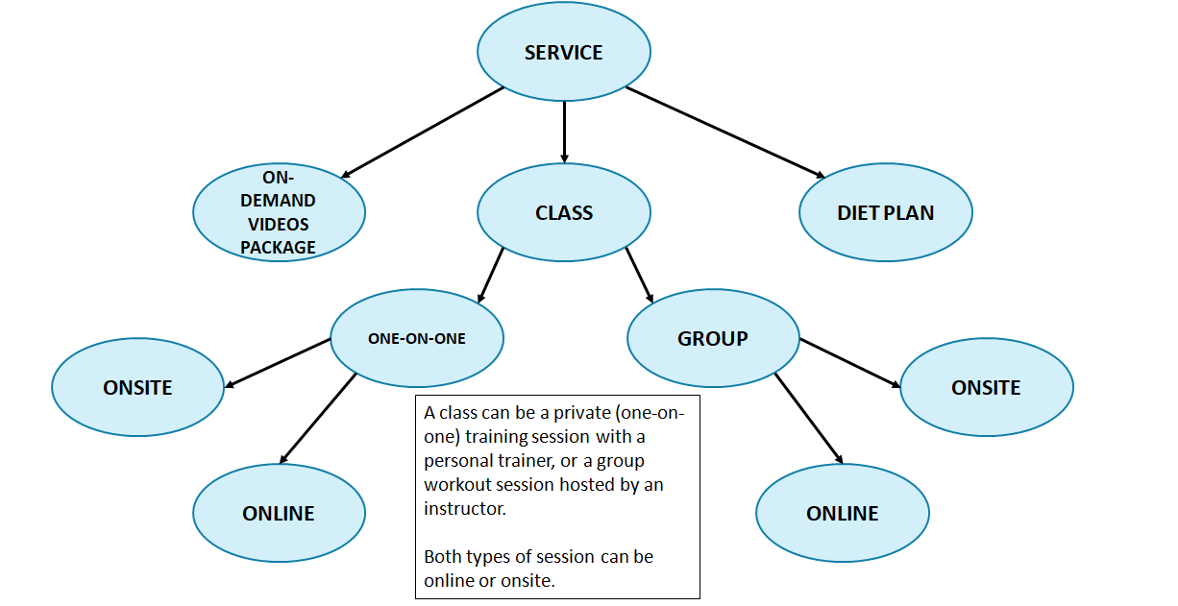
Visual Representation Of Types Of Services Offered On Our Web Application

Slide 11
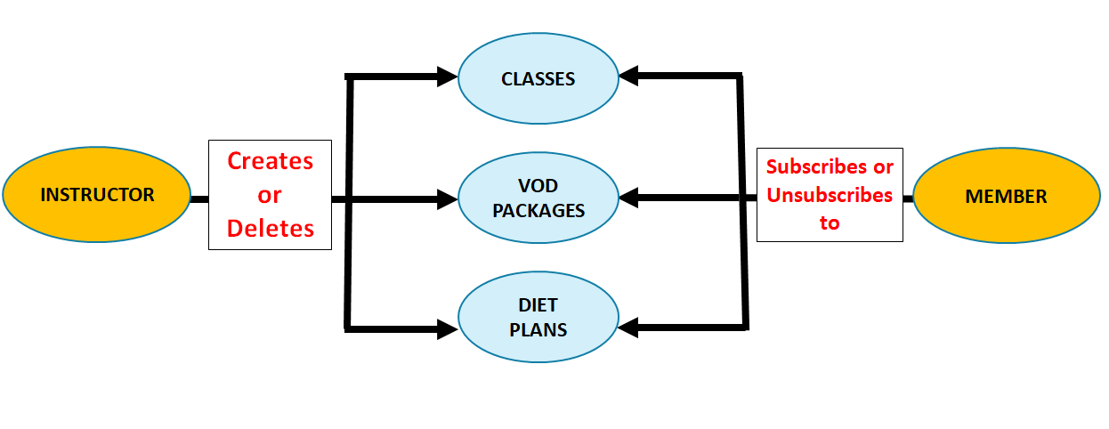
Visual Representation Of The Workflow

Slide 12
DETAILS OF WORKFLOW
The application has two types of users and therefore different interfaces for each.
The member’s interface:
Allows the member to search for a service. They can enter their preferences to apply filter to the search results and view only those services that are closest to their preference.
Show member the details of services they currently have access to.
Provides link to live stream sessions, VOD packages, and diet plans.
The instructor’s interface:
Allows the instructor to create a service that can be a live stream session, VOD package, or diet plan.
Allows the instructor to delete (stop offering) a service.
Show the instructor all the services they are currently offering at your gym.

Slide 13
HOW DOES MEMBER GET ACCESS TO EACH SERVICE?
For a live stream session, members get access to a zoom link that directs them to the session.
For a VOD package, members get access to a private YouTube playlist that has all the recorded workout videos.
For a diet plan, members get access to a link that directs them to a page containing all the details of the diet plan.

Slide 14
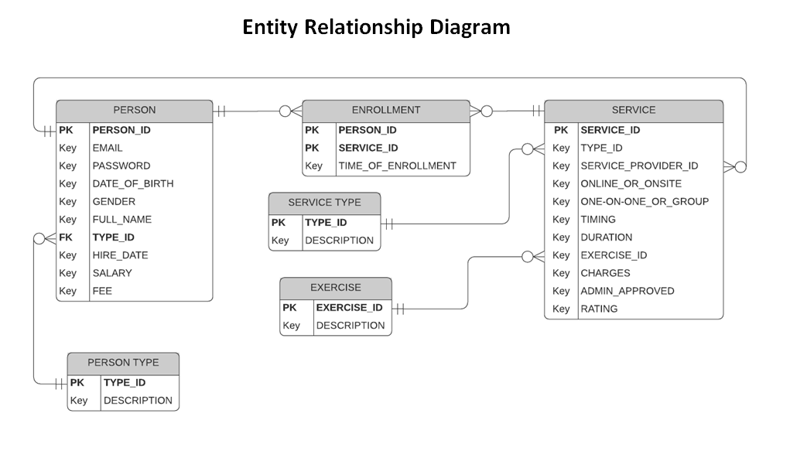
ERD

Slide 15
TOOLS EMPLOYED TO CREATE THE WEB APPLICATION
Tools used for frontend: HTML, CSS, JavaScript, Bootstrap.
Tools used for backend: MySQL, Python, Django.

Slide 16
Software Engineering Work
We did requirements engineering based on survey analysis
Created Use Case based on requirements specification
Created class diagram to understand relationship between classes
For workflow engineering we made sequence, state chart, activity, component diagrams.

Slide 17
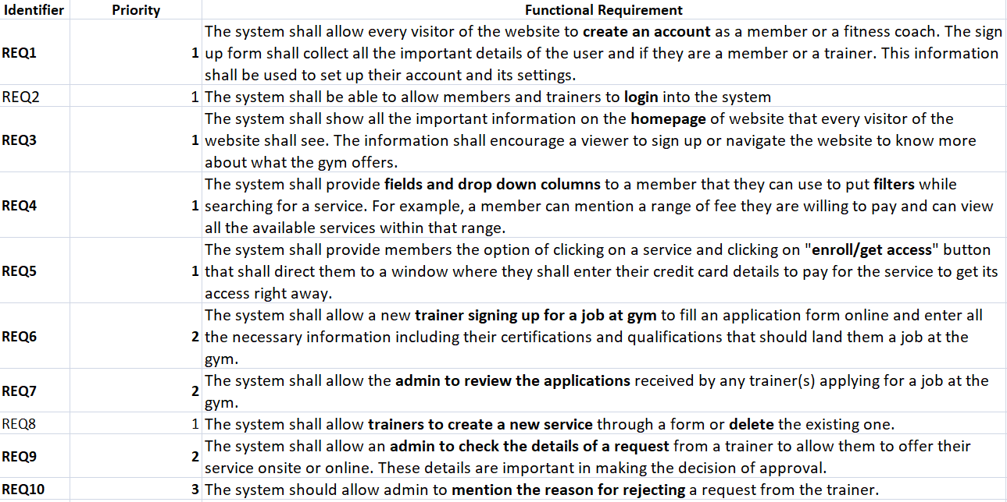
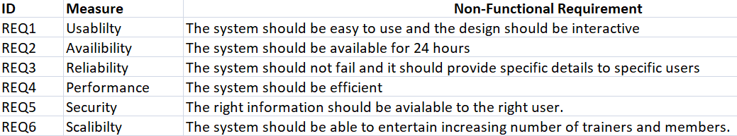
Requirements
Scale
Mandatory
Desired
Optional
Future

Slide 18
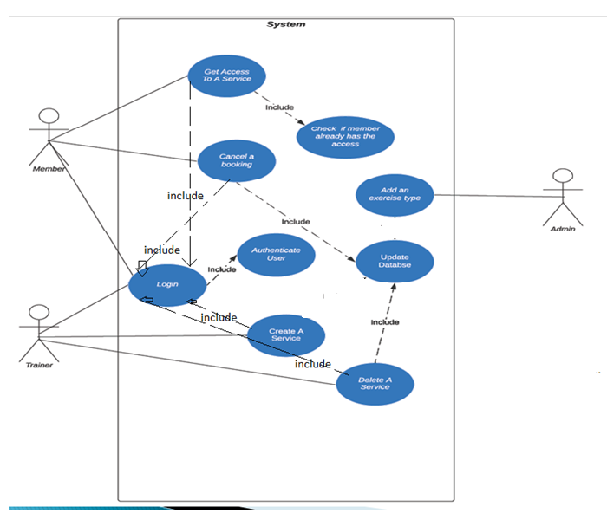
Use Case Diagram

Slide 19
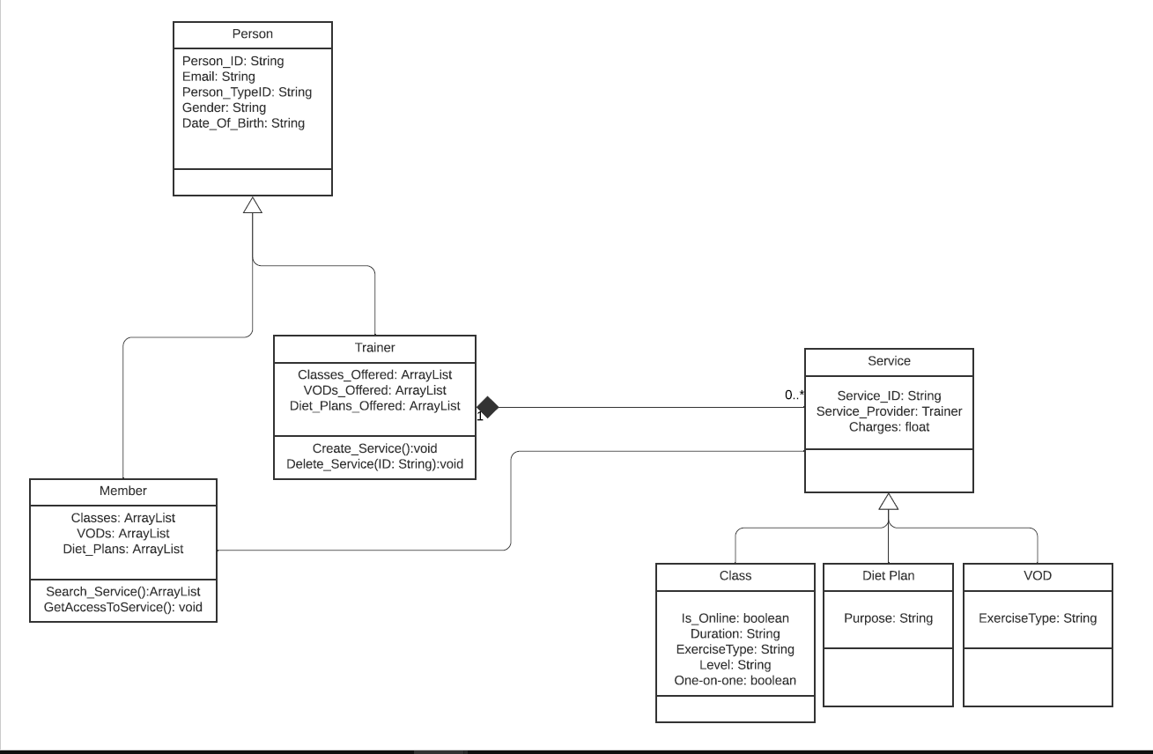
UML/Class Diagram

Slide 20
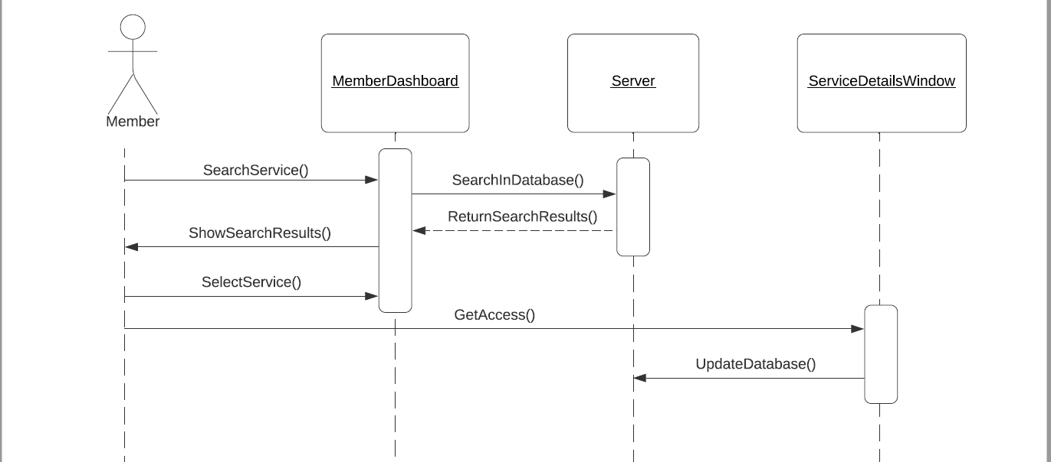
Sequence Diagram – Member Searching and Booking Service

Slide 21
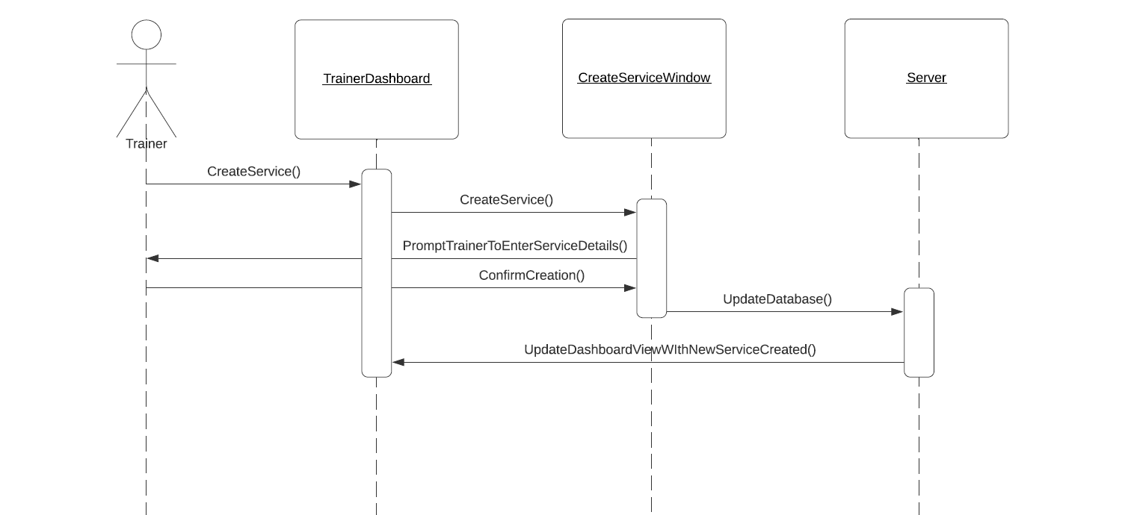
Sequence Diagram – Trainer Creating a Service

Slide 22
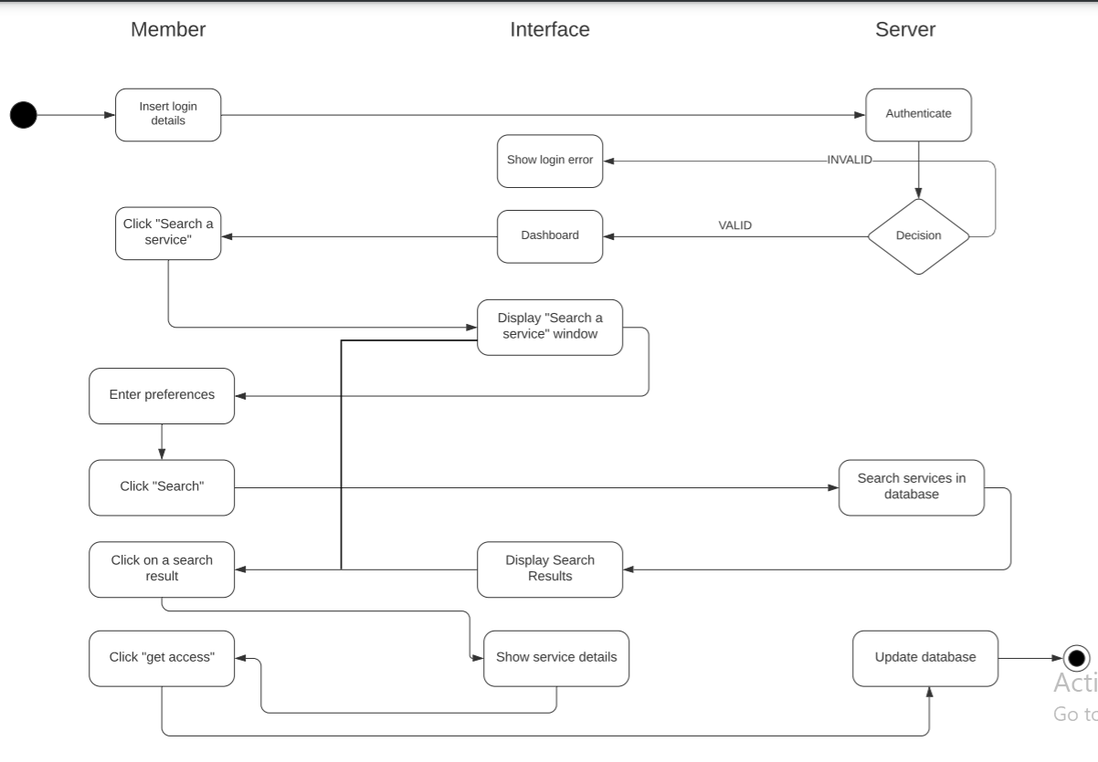
Member Activity Diagram

Slide 23
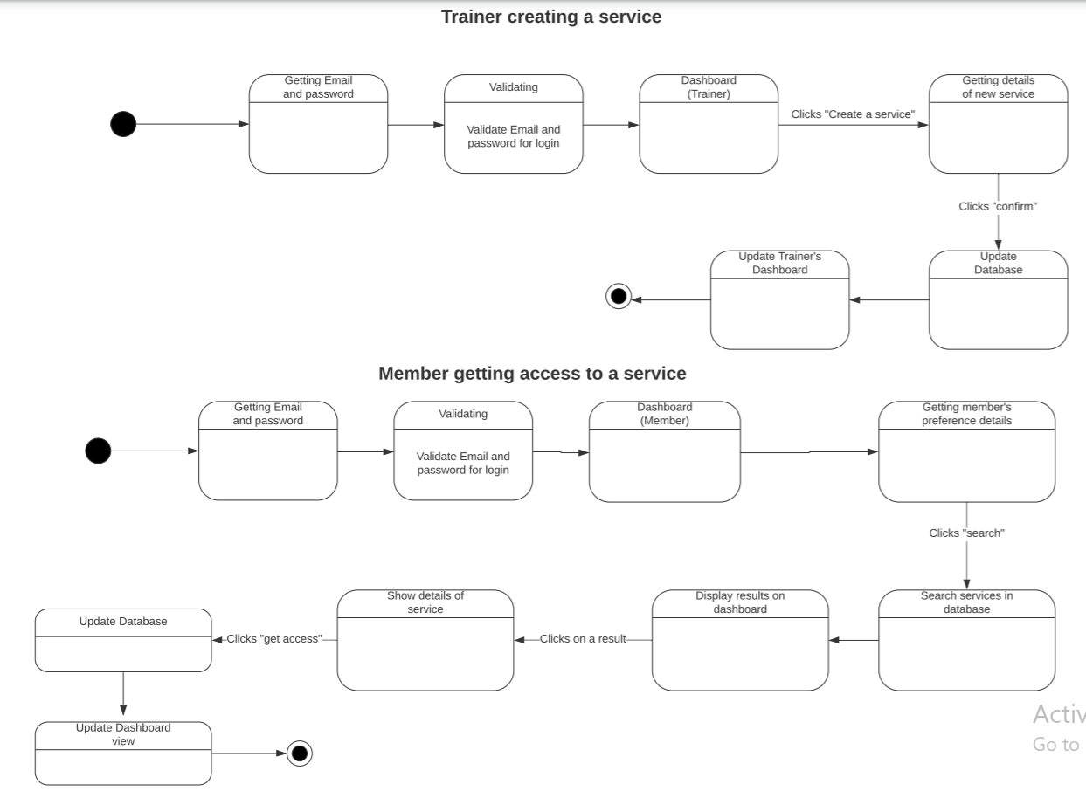
State Chart Diagram

Slide 24
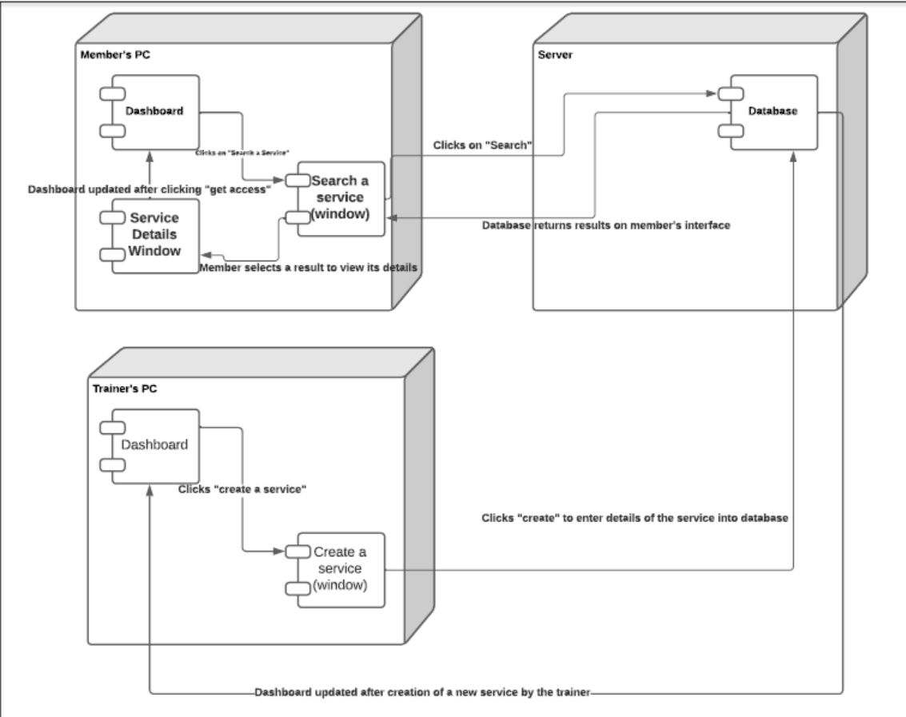
Component and deployment Diagram

Slide 25
THANK YOU!

